Slide 1
Some Possibly Useful Graphics Functions
Lunch presentation

Slide 2
GGPlot2
Hadley Wickham
Grammar Of Graphics
GGPlot2 Website
If I see it on the GGPlot2 page it might be easier/better looking to use than using R plot function

Slide 3
Syntax
What I’m used to:
  Plot(x,y, col=whatever, main=whatever)
  Legend(…)
  par(mfrow=c(1,2))

Slide 4
Syntax
What I’m used to:
  Plot(x,y, col=whatever, main=whatever)
  ggplot(dataFrame,aes(x,y,sometimes z) +
  the name of the plot you want +
  Legend(…)
  + options like labels/colors/text/lines
  par(mfrow=c(x,y))
  grid.newpage()
  pushViewport(viewport(layout = grid.layout(x, y)))
  viewport(layout.pos.row = x, layout.pos.col = y)

Slide 5
How Might it be Useful
Do you have your data in a data.frame?
Are you ok with acceding control of the details?
Do you anticipate summarizing your data by one or more variables in your data frame?
Do you see your plot or something like it on Hadley’s page?

Slide 6
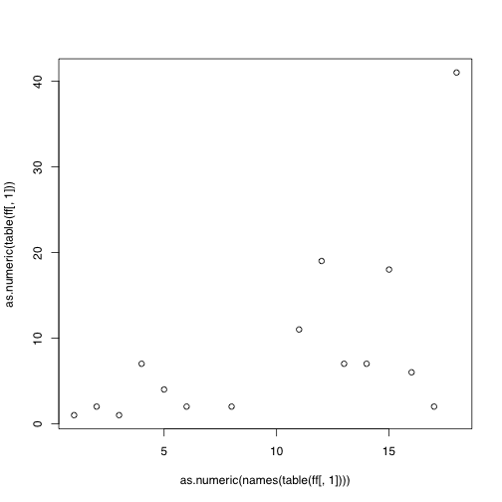
R Plot Function

Slide 7
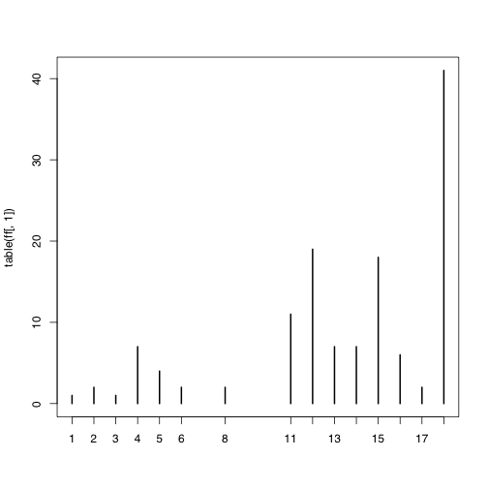
R Plot Function Again

Slide 8
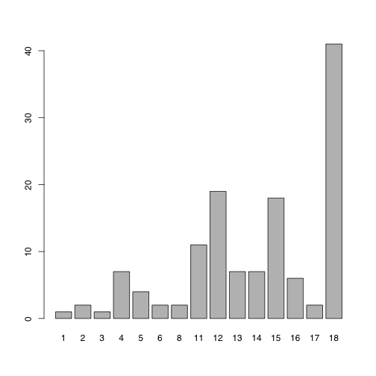
R Barplot Function

Slide 9
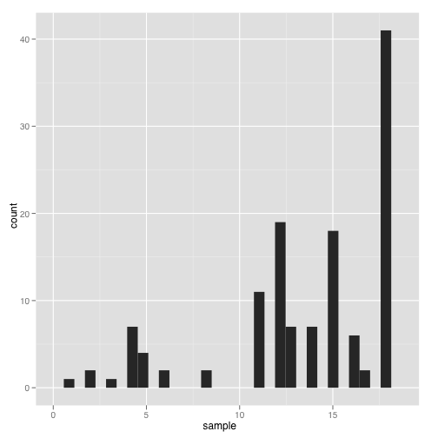
geom_bar

Slide 10
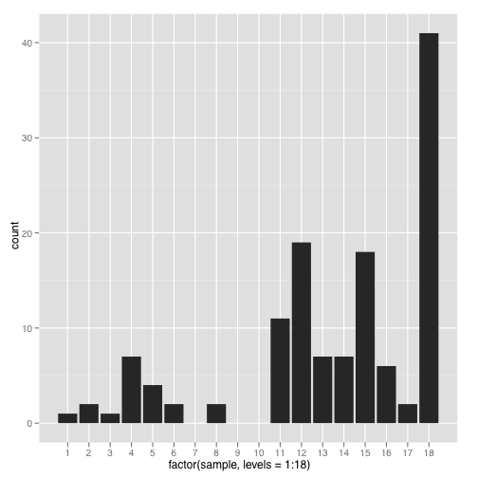
Specify Factor Levels

Slide 11
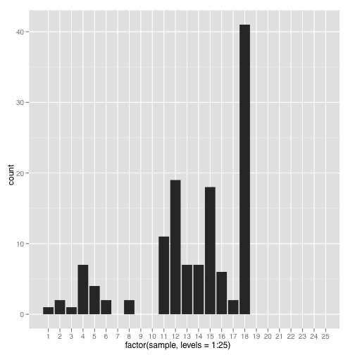
Specify Arbitrary Factor Levels

Slide 12
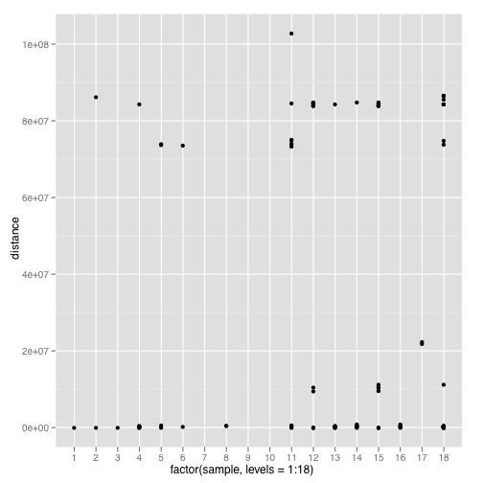
geom_point

Slide 13
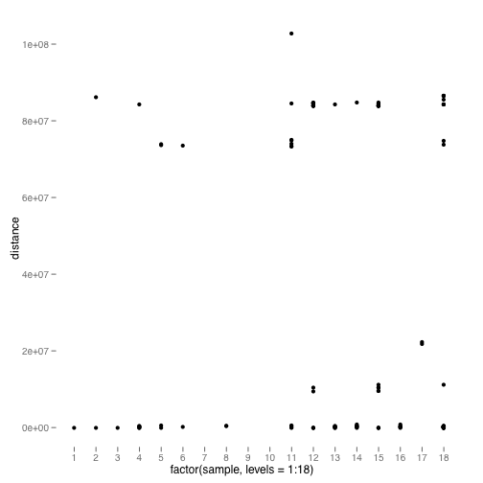
Remove Background Grid

Slide 14
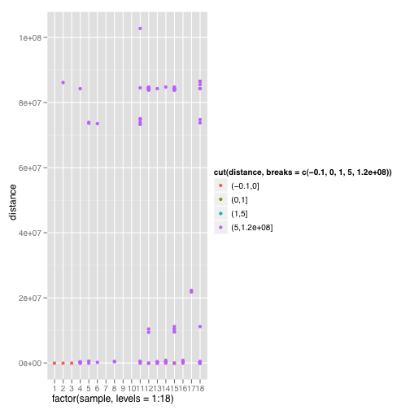
Specify Colors

Slide 15
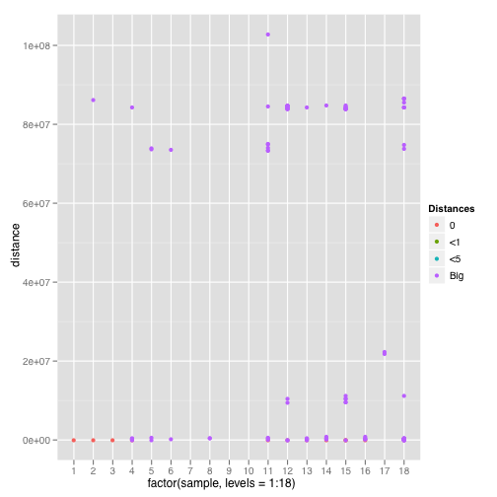
Change legend label

Slide 16
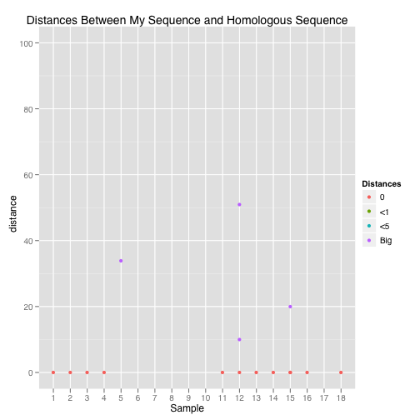
Change title and axes labels

Slide 17
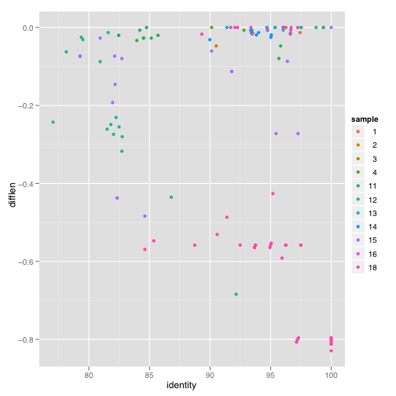
geom_point

Slide 18
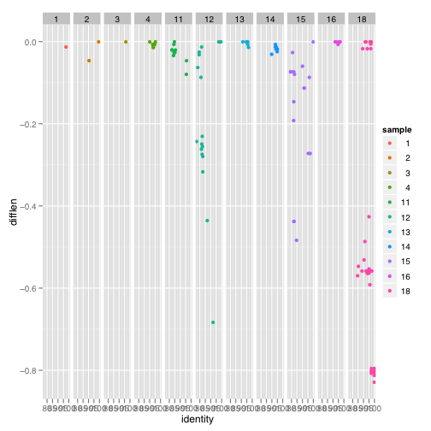
Facet by sample

Slide 19
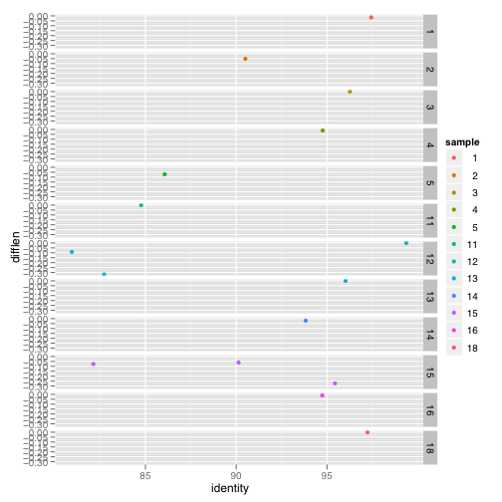
Flip it

