Slide 1
Parallel R
Andrew Jaffe
Computing Club
4/5/2015

Slide 2
Overview
Introduction
multicore
Array jobs
The rest

Slide 3
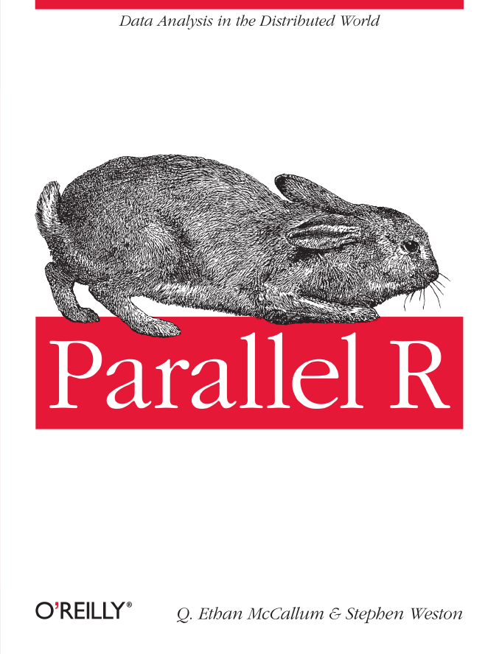
Introduction
Based roughly on: McCallum and Weston. Parallel R. 2012 (O’Reilly Book), so consult for the more complicated methods

Slide 4
Introduction
Permute Outcome/
Bootstrap (B times)
Calculate statistical significance
Calculate Stat
Find Null Stats

Slide 5
Introduction
Permute Outcome/
Bootstrap (B times)
P cores:
Find Null Stats
Find Null Stats
1 core:
1 core:
1 core:
…
…
…
Calculate statistical significance
Calculate Stat
Combine Null Stats
Find Null Stats
Find Null Stats

Slide 6
Introduction
Basically two ways of doing parallel jobs
Submit multiple “jobs” prepared to run in parallel across one or more nodes – each uses one core
Use multiple cores on a given node – note that you’re limited by the number of cores on that node

Slide 7
Introduction
The computing cluster is a shared resource – be careful when running jobs on multiple cores on one node (and slightly less so for parallel jobs across nodes)

Slide 8
Overview
Introduction
multicore
Array jobs
The rest

Slide 9
The multicore R Package
library(multicore)
This is definitely the easiest/most straightforward way to run things in parallel
The easiest function to use is mclapply() - works exactly the same as lapply()
Only works on Linux/Mac (!)

Slide 10
The multicore R Package
McCallum and Weston. Parallel R. 2012

Slide 11
apply()
“list apply” → if you haven’t used any of the apply functions before, definitely check them out (apply, lapply, sapply, tapply)
apply(data, margin [row=1,col=2], function)
Applies function along rows or columns of a matrix or data.frame
x = matrix(rnorm(100),nc = 10)
apply(x, 1, function(x) mean(x))
Each row is ‘x’, assessed in the function

Slide 12
apply()
Some functions don’t need to be written like that: mean, length, class, sum, max, min, …
apply(x,1,mean)
apply(x,1,max)

Slide 13
lapply()
Instead of applying a function to every row or column, applies a function to every element of a list → returns a list
list: collection of elements of different classes and different dimensions
You can have lists of different sized data.frames and matrices
Basically 3D R object (1D = vector, 2D = matrix)

Slide 14
lists
> y= list(c(1:5), c(6:21), c(3,7))
> y
[[1]]
[1] 1 2 3 4 5
[[2]]
[1] 6 7 8 9 10 11 12 13 14 15 16 17 18 19 20 21
[[3]]
[1] 3 7
> y[[1]] # select 1 element, now a vector
[1] 1 2 3 4 5
> y[1:2] # select multiple elements
[[1]]
[1] 1 2 3 4 5
[[2]]
[1] 6 7 8 9 10 11 12 13 14 15 16 17 18 19 20 21

Slide 15
mclapply()
Does lapply(), but splits the work over multiple cores on your node
All you need to control/input is how many cores it should use – the function does all the splitting and reassembling
mclapply(theList, function, mc.cores)

Slide 16
mclapply()

Slide 17
Enigma/Cluster
You need to explicitly request multiple cores on jobs → do not use multicore functions if you have not
This is a node log-on request for 4 cores, with a total memory max of 32 Gbs, and
qrsh -pe local 4 -l mf=32G,h_vmem=3G
h_vmem is the upper memory limit when the job dies → memory_limit/no_cores^2, so 48G

Slide 18
Enigma/Cluster
Works the same as submitting jobs with qsub
I just have aliases set up in my ~/.bashrc file
alias qsmult='qrsh -pe local 4 –l mf=32G,h_vmem=2G'
alias qssmult='qsub -V -pe local 3 -l mf=32G,h_vmem=2G -cwd -b y R CMD BATCH --no-save'

Slide 19
Overview
Introduction
multicore
Array jobs
The rest

Slide 20
Array jobs
“An SGE Array Job is a script that is to be run multiple times.”
“Note that this means EXACTLY the same script is going to be run multiple times, the only difference between each run is a single environment variable, $SGE_TASK_ID, so your script MUST be reasonably intelligent.”
https://wiki.duke.edu/display/SCSC/SGE+Array+Jobs

Slide 21
Array jobs
qsub -t 1-10 -V -l mf=20G,h_vmem=32G -cwd -b y R CMD BATCH --no-save sim1_GO_spikein_v2.R
The sim1_GO_spikein_v2.R script is submitted 10 times
An incremented “environment” variable is assigned to each, here from 1 to 10 (-t 1-10)
Within each script, I initiate a variable
runId = Sys.getenv("SGE_TASK_ID")
Which assigns the ‘t’ value to runId

Slide 22
Array jobs
So, I have 10 jobs running, each with a different value of runId
At the end of the script, I can use paste() and save the data from each job as separate files:
save(whatever, file = paste("results",runId,".rda",sep=""))
Then you have to manually (and carefully) append/collect all of the data back together

Slide 23
Array jobs
Note that unlike jobs on multiple cores on one node, these jobs are assigned nodes like any other job you create using qsub
You are therefore not limited by the number of cores on a node, but rather the number of ‘slots’ you can use (I think its around 10)
Also note that it’s hard to get more than 4 cores on a node (or even more than 3)
Lastly, your 1 array job gets one job ID (see qstat), so you can easily delete it using qdel

Slide 24
Overview
Introduction
multicore
Array jobs
The rest

Slide 25
The rest…
These are from the Parallel R book, and I haven’t directly used them:
McCallum and Weston. Parallel R. 2012

Slide 26
The rest…
Also in multicore package:
McCallum and Weston. Parallel R. 2012

Slide 27
The rest…

Slide 28
The rest…
And on Amazon…
McCallum and Weston. Parallel R. 2012

Slide 29
Questions?

