Slide 1
Lab1: Getting Started with R
SHOU Haochang (寿昊畅)
Department of Biostatistics, Johns Hopkins Bloomberg School of Public Health
July 11th, 2011
Nanjing University, China
*Thanks to Prof. Ji and Prof. Ruczinski for some of the lecture materials

Slide 2
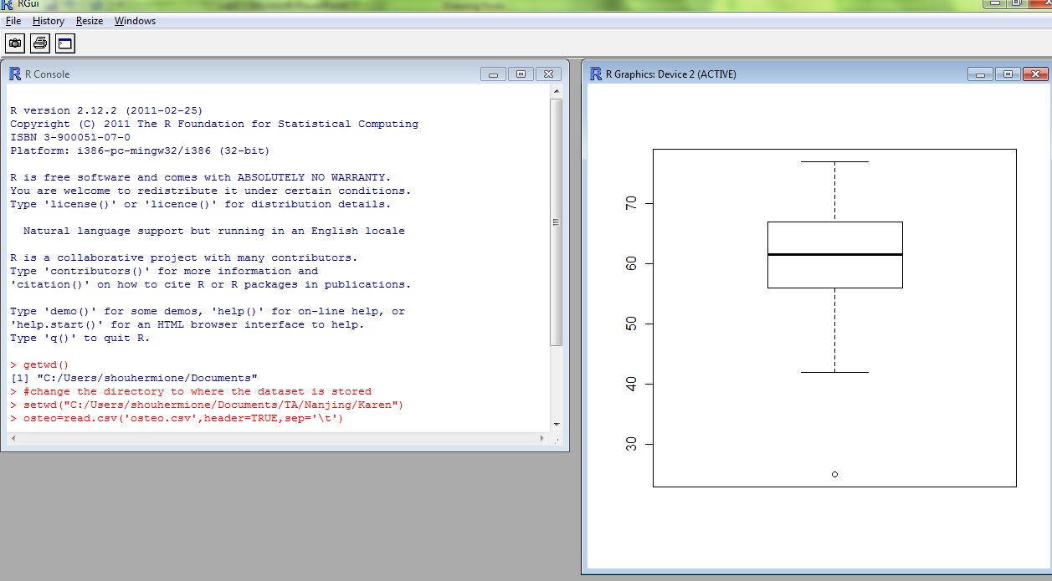

Slide 3
Some Facts about R
A system for data analysis and visualization which is built based on S language.
Open source and open development
First developed by Robert Gentleman and Ross Ihaka—also known as "R & R" of the Statistics Department of the University of Auckland.
The first version was released in 2000; the latest version is R 2.13.1
Flexible, can interact with C/WinBUGS/Matlab and database

Slide 4
Download and Setup
Official Website http://www.r-project.org
CRAN (The Comprehensive R Archive Network)
http://cran.r-project.org/
Choose your mirror site, e.g. http://cran.csdb.cn/
Windows user: download and run R-2.13.0-win.exe file.
Mac user: download R-2.13.1.dmg

Slide 5
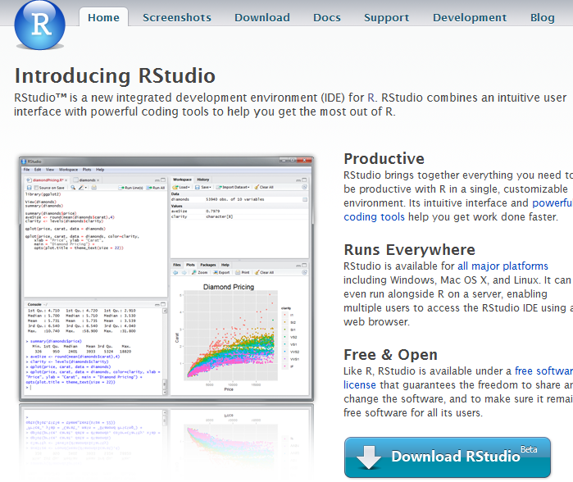
R Studio http://rstudio.org/

Slide 6
Simple Syntax to Begin with
R command is case sensitive !!
Comment with a hashmark (#)
Set working directory
>getwd() >setwd("C:/Users/shouhermione/Documents/TA/Nanjing/Karen")
Data Type
numeric, complex(1+2i), character(‘A’/”hello world!”), logical(TRUE/FALSE)
Class of object
vector, matrix, list, data frame, function

Slide 7
Vector, matrix and array
> x<-1:10
> x
[1] 1 2 3 4 5 6 7 8 9 10
> w=c(x,0.3,-2.1,5.7)
other useful functions for creating a vector: seq(), rep()
> y<-matrix(1:6,nrow=2,ncol=3,byrow=FALSE)
> y
[,1] [,2] [,3]
[1,] 1 3 5
[2,] 2 4 6
> y[2,1]
> z<- array(1:9,dim=c(3,3,3))
Element-wise arithmetic operator:
+, -, *, /, %/%, %%
summary(), mean(), median(),sd(),sum(),max(),min(),sort(),order()
Notes:
Left arrow for assignment
matrix() is a function with parameter
c stands for concatenate

Slide 8
List and Data Frame
List is an object whose components can be of different classes and dimensions.
> x<-list(gender=c('F','M'),grade=c(98,100,90),undergrad=FALSE)
> x$gender
> x[[1]]
> names(x)
Data frame is a list where the components have the same length
> y<-data.frame(gender=c('F','M'),grade=c(98,100),undergrad=c(FALSE,TRUE))
> y$grade, y[,2]
> indices same as matrices y[1,2], y$grade[1]
> nrow(y), ncol(y)

Slide 9
Input and Output Data
Read in data frame
read.table() – ASCII file;
read.csv() – Excel/CSV file
> dat<-read.csv('osteo.csv', header=TRUE, sep=‘,’)
> dat<-read.table(‘osteo.txt’, header=TRUE, sep=‘ ’)
read.table is not suitable for large matrices with many columns. Use ‘scan’ instead.
Output the data
> write.table(dat, ‘osteo2.txt’,col.names=TRUE, sep=‘\t’)
Save and reload the .RData
save(); load()
Notes:
Read.table is used to read data frames which may have columns of very different classes. But it’s

Slide 10
Loops
Calculate 4!=? ‘for’ and ‘while’
s<-1
for(i in 1:4){
s=s*i
}
print(s)
s<-4
j<-4-1
while(j>=1) {
s=s*j
j=j-1
}

Slide 11
Finding Help
Know the exact name of the function
help(mean), ?mean
Don’t know the name
help.search(‘mean’), ??mean
help.start() Go to R’s online documentation
Search and post questions on the mailing list
Google!

Slide 12
Graphics in R

Slide 13
Scatter plots, boxplots, histograms, Stem-and-leaf plots, QQ plots, images…
> x<-seq(from=0,to=1,length=50)
> w<-2*cos(4*pi*x) #true value
> e<-rnorm(50,mean=0,sd=.5) #random errors
> y<-w+e
> plot(x,y,type='l',ylim=c(-3,4))
> lines(x,w,col='blue',lwd=2,lty='dashed')
> legend('topright',legend=c('with noise','true value'),col=c('black','blue'),lty=c('solid','dashed'),lwd=c(1,2))

Slide 14
op<-par(mfrow=c(2,2))
plot(dat$Age, dat$DPA,main='DPA vs. age',xlab='age',ylab='DPA',col='blue')
hist(dat$DPA,main='Histogram of DPA')
boxplot(dat$DPA~dat$Osteo,main='Boxplot of DPA by disease status')
qqnorm(dat$DPA)
qqline(dat$DPA)
par(op)
Notes:
Pdf()

Slide 15
R Packages
Download and install packages; load the package for use
e.g., library(SemiPar)
Bioconductor
two releases each year, more than 460 packages;
statistical tools built by R for high-dimensional genomic data analysis

Slide 16
Some Useful Sources
An Introduction to R by Venables and Smith
Email list
Prof. Ji’s website for statistical computing
http://www.biostat.jhsph.edu/~hji/courses/statcomputing/
http://www.biostat.jhsph.edu/~bcaffo/statcomp/index.html
统计建模与R软件 by 薛毅
人大统计之都 COS论坛 http://cos.name/cn/

